Slide 1
Creating a Subset
Patrick Mathias
DLMP Core

Slide 2
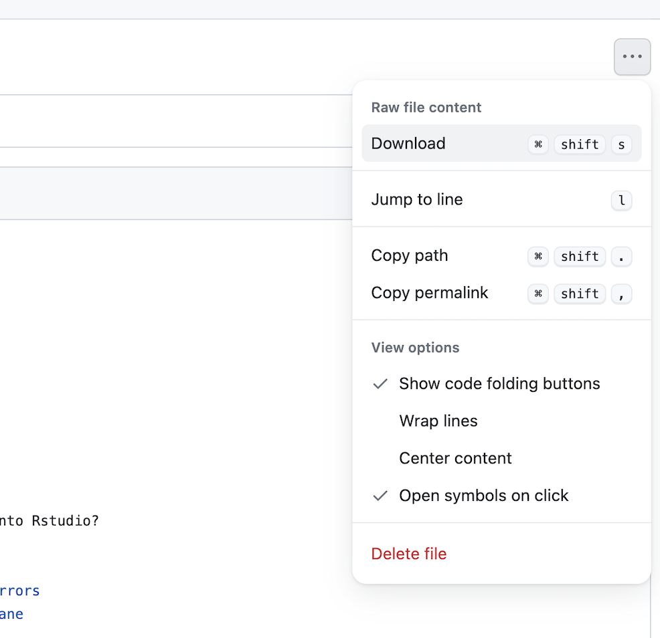
Lesson Prep
Locate the “04 – Transform” qmd file on the course website.
Navigate to the file and use the menu on the top right to download.
Upload to your core folder on the RStudio server

Slide 3
Lesson Goals
Perform basic data cleaning and preparation steps to facilitate analysis
Illustrate best practices for organizing data in spreadsheet-based (rectangular) formats for use in data analytics
Lesson Objectives
Apply logical criteria to determine which observations in a dataframe are included in a subset
Create a new variable based on a calculation applied to other variables
Notes:
In the second session we will learn some fundamentals of coding including using functions, creating objects, and importing data.

Slide 4
Typical Data Science Pipeline
Tidy
Transform
Notes:
This is the generalized data science pipeline that was introduced to you yesterday. The functions we'll be learning about fit specifically in the "tidy" and "transform" portions of this workflow.

Slide 5


What is a “Tidy” Data Frame
A data set is tidy if:
Each variable is in its own column
Each observation is in its own row
Each value is in its own cell
MRN
Notes:
So let's quickly review what we mean by a tidy dataset. By definition it essentially describes a data set in which
→ variables or features are recorded in columns
→ Each row represents a single observation
→ And finally each cell contains only one value.
This is admittedly somewhat abstract. The way that I think about it is that a tidy data set is one that is at the point where it is cleaned up and ready to be analyzed either using statistical analysis or through a visualization.
The opposite is a messy data frame which is generally how data comes at us in the real world. Its basically in a form that makes it difficult or impossible to analyze without processing.

Slide 6
Your Turn #1
Open “04 – Transform.qmd”
Read and complete the “Using a Setup Code Chunk” section
Put your sticky up when done

Slide 7
Notebooks are reproducible, with caveats
Notebook formats like Quarto and Jupyter notebooks (Python) are great for organizing multi-step data analyses
Important to consider that running code chunks sequentially may not produce the same output as jumping around a notebook
Best practice: run your notebook sequentially at the beginning and end of each “session” analyzing data
Confirm the output is as expected

Slide 8
Data Transformation with dplyr

Slide 9

Transform Data with
Notes:
In this session we'll be using functions that are part of the dplyr package. The dplyr package is a workhorse for data transformation and since its part of the tidyverse meta-package you just loaded it with the code chunk from the Your Turn.

Slide 10
dplyr
dplyr implements a grammar of data manipulation for transforming tabular data.
dplyr is one of many packages that are loaded when you execute library(tidyverse)
Notes:
Now dplyr isn't just a haphazard collection of functions. It takes a holistic almost philosophical approach to the transformation of data and implements it in an organized lexicon or grammar for programmatically transforming data.
What I mean when I say a grammar for transforming data really relates to 2 characteristics of the dplyr approach.
#1 In a similar way to how verbs operate on nouns, dplyr functions operate on data frames.
#2 Dplyr functions use a consistent syntax which minimizes cognitive load so once you understand the dplyr approach with one function, it's easier to learn new functions in dplyr.

Slide 11
dplyr: a grammar for transforming data
1
Choose columns.
select()
2
Extract rows.
filter()
3
Derive new columns.
mutate()
4
summarize()
Change the unit of analysis.
Notes:
This session is about getting to know these functions. Data wrangling can require a lot of different manipulations and dplyr has a wealth of functions to help you with this, but most data wrangling in my experience will involve one of these four actions
Starting with the raw data, youll need to choose the columns you want, define and extract the rows of interest, you will likely need to derive new calculated columns and finally often we have to aggregate data with a summary.
→
Dplyr implements four functions that handle each of these actions, Select, Filter, Mutate, and Summarize. In this session we'll be discussing the first 3, and the last one will be covered in the next one.

Slide 12
Dplyr Approach
ƒ(
)
Notes:
Another feature of the dplyr approach to data manipulation is that each function in the package is tuned to do one thing, meaning to change the data in one way.
What this means is that if you have several changes you need to make to the dataset - you won't be applying one function to get it to the end result as you see on this slide.

Slide 13
Dplyr Approach
ƒ(
)
ƒ(
)
4 columns x 7 rows
6 columns x 11 rows
ƒ(
)
5 columns x 7 rows
4 columns x 11 rows
Notes:
Rather a typical workflow involves making one tweak to the data at a time, going through a sequence of steps, each one carried out by one function to get you to the final tidy dataset.

Slide 14
Common syntax
Each function takes a data frame as its first argument and returns a data frame as its output.
function(data, ...)
dplyr function
data frame to transform
specific arguments
14
Notes:
One of the major advantages of using dplyr functions in your data analysis is that dplyr functions all use a common syntax, which makes them easier to learn.
Each one will take a data frame as the first argument, which will be followed by additional arguments that basically serve as instructions to the function on how to operate on the data frame. The output of dplyr functions is always another data frame.

Slide 15
Filtering a Subset of Rows
Notes:
The first set of functions we will explore will be ones whose primary goal is to extracting the data of interest from a large and often messy pile of data.
Reducing a dataset to a narrow subset of columns and rows is often the first step in an analysis.

Slide 16
filter()
Extract rows that meet logical criteria
↓ Number of rows
= Number of Columns
Notes:
Here you see the graphical framework for how filter works. You provide the raw data as the input in the form of a data frame.
Filter will use logical criteria that you provide in the function, to identify the rows that are required
In the output, you will wind up with all the columns that you started with and just the rows defined in the filter function.

Slide 17
Common syntax
Each function takes a data frame as its first argument and returns a data frame as its output.
function(data, ...)
dplyr function
data frame to transform
specific arguments
Notes:
Recall that all dplyr functions hew to a common syntax and filter is no exception →

Slide 18
filter()
Extract rows that meet logical criteria
filter(data,... )
one or more logical tests (filter returns each row for which the test is TRUE)
data frame to transform
 |  |  | FALSE
 |  |  | FALSE
 |  |  | TRUE
 |  |  | FALSE
 |  |  | TRUE
 |  |  | FALSE
Notes:
In filter the first argument again is a data frame from which we will be extracting rows.
Afterwards we can input one more logical tests. R then performs that logical test on each row of the dataset and returns all rows in which the logical test is TRUE. Rows for which the tests are TRUE are returned in the output as a data frame and the rest are removed.
The key point here is that the logical tests are evaluated row by row, one at a time, independently.

Slide 19
filter()
Extract rows that meet logical criteria
filter(data, column_name == criteria )
one or more logical tests (filter returns each row for which the test is TRUE)
 |  |  | FALSE
 |  |  | FALSE
 |  |  | TRUE
 |  |  | FALSE
 |  |  | TRUE
 |  |  | FALSE
Notes:
Let's zoom in for a second on those logical tests.
Generally speaking they will take this form.
There will be some column that contains the data you want to filter on, like the clinic name, or the patient MRN.
Then there will be a logical test, what you see here is equals, you can also have greater than, less than etc.
And then you have the criteria. Equal to what? Greater than what number?
OK let's see some real examples →

Slide 20
filter()
Extract rows that meet logical criteria
filter(chem, mrn == 111900)
mrn | age | last_name
123858 | 24 | maxwell
123858 | 24 | maxwell
112927 | 64 | harrington
111900 | 55 | simmons
mrn | age | last_name
111900 | 55 | simmons
FALSE
FALSE
FALSE
TRUE
Notes:
Here's an example. We supply the covid_testing data frame as the first argument. Afterwards we provide one logical test; we ask filter() to return rows in which the mrn is 5000083.
Filter will go row by row, starting from the very first row and ask is the value in the mrn column equal to 500083 for that row, as you can see it's not – so it gets an imaginary value of false. →
It then goes to the second row, again checks to see if the mrn is a match, it's not so it also get's a false.→
And so on for the third →
But in the fourth you can see we do have a match – so that gets a TRUE. →
So the output of this function is a data frame with the same number of columns but only the rows that resulted in a TRUE based on the criteria in the function

Slide 21
filter()
Extract rows that meet logical criteria
filter(chem, mrn == 111900)
mrn | age | last_name
123858 | 24 | maxwell
123858 | 24 | maxwell
112927 | 64 | harrington
111900 | 55 | simmons
= sets
(returns nothing)
== tests if equal
(returns TRUE or FALSE)
Notes:
Note that I used double equals inside of the logical test. Double equals means: compare the left hand to the right hand sides and if it’s the same, then return TRUE. The double equals is called the comparison operator. In contrast, a single equals sign sets a variable (the left side) to a value (usually on the right). It is a very common mistake to accidentally use a single equals inside of the filter function, which will result in an error.

Slide 22
filter()
Values coded as character strings must be surrounded by quotes
Extract rows that meet logical criteria.
filter(chem, last_name == “maxwell")
mrn | age | last_name
123858 | 24 | maxwell
123858 | 24 | maxwell
112927 | 64 | harrington
111900 | 55 | simmons
mrn | first_name | last_name
123858 | 24 | maxwell
123858 | 24 | maxwell
TRUE
TRUE
FALSE
FALSE
Notes:
Similarly we can ask filter to return just the rows that represent tests for a specific patient, like stark.
In this case the first two rows result in TRUE and so are kept
Note that when asking filter to return rows with specific text inside of it, we have to put that text in quotes and it's got to be an exact match, partial matches don't count.

Slide 23
filter()
Extract rows that meet logical criteria
filter(data,... )
one or more logical tests (filter returns each row for which the test is TRUE)
data frame to transform
Notes:
So what we've seen is that the output of a filter() function is completely dependent on the logical operators in this green rectangle. Rows in which the logical statement results in a TRUE are returned and those that are FALSE will not be returned. So the next question of course is how do you construct logical statements in R.

Slide 24
Logical tests
x < y | Less than
x > y | Greater than
x == y | Equal to
x <= y | Less than or equal to
x >= y | Greater than or equal to
x != y | Not equal to
x %in% y | Group membership
is.na(x) | Is NA
!is.na(x) | Is not NA
Notes:
R provides logical operators for every occasion. Here are just some of the important logical operators to know about.
We’ve already seen the double equals. Theres also the less than or and greater than operators. These each also come as “or equal to” versions.
Use exclamation point-equals (!=) if you want to select rows in which a value is not equal to something else.
There are more here that we won't get into at the moment.

Slide 25
Multiple criteria can be included as arguments to the function
filter(chem, age >= 50, gender == “Female”)
mrn | age | gender
123858 | 50 | Female
123858 | 50 | Female
112927 | 64 | Male
111900 | 45 | Female
mrn | first_name | last_name
123858 | 50 | Female
123858 | 50 | Female
TRUE
TRUE
FALSE
FALSE
Notes:
Similarly we can ask filter to return just the rows that represent tests for a specific patient, like stark.
In this case the first two rows result in TRUE and so are kept
Note that when asking filter to return rows with specific text inside of it, we have to put that text in quotes and it's got to be an exact match, partial matches don't count.

Slide 26
Quiz
What is the result?
1 == 1

Slide 27
Quiz
What is the result?
3 != 1

Slide 28
Your Turn #2
Read and complete the “Creating a Subset Using filter” section
Put your sticky up when done

Slide 29
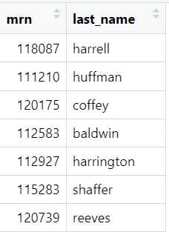
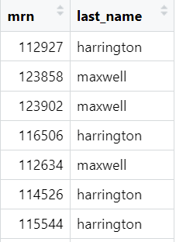
filter()
Filter to multiple matches
filter(chem, last_name %in% c(“maxwell",“harrington"))

Slide 30
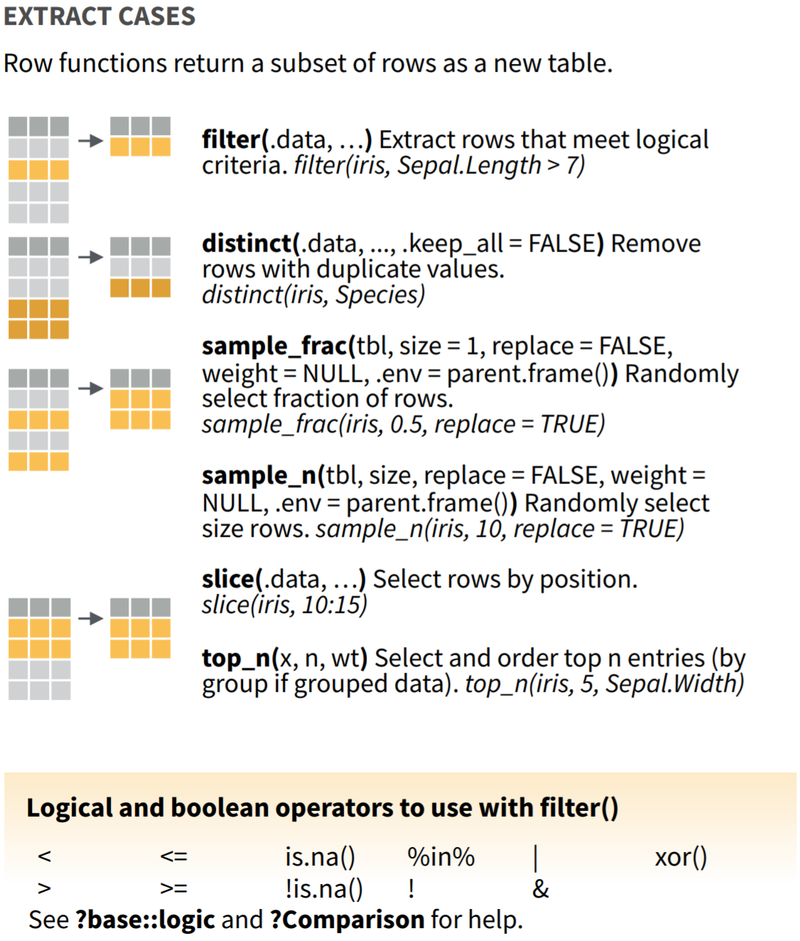
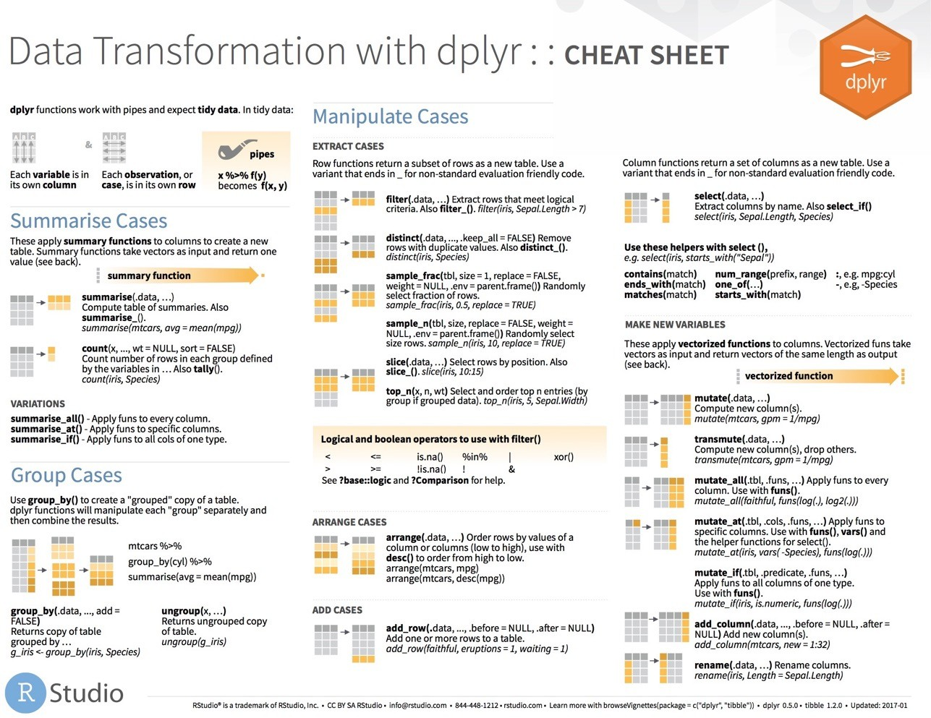
filter() variants
Notes:
Now filter() is only one of many functions that dplyr provides to allow you to extract the rows you want from your data. For a more comprehensive sampling see the Manipulate cases section on the dplyr cheatsheet.

Slide 31
Creating a New Column
Notes:
So now let's shift gears and discuss how we can derive new information from the raw data that we're provided

Slide 32
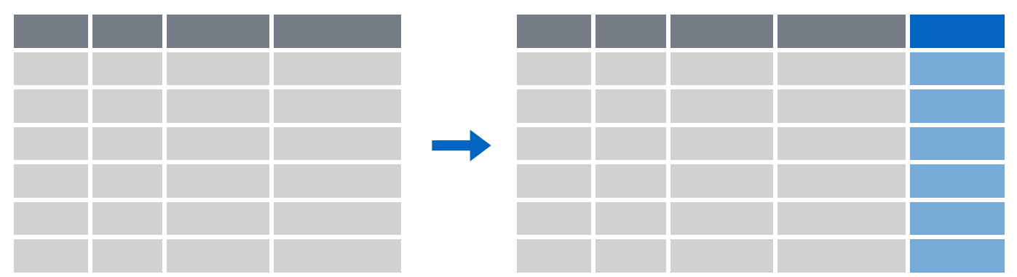
mutate()
Creating new calculated columns
= Number of rows
↑ Number of Columns
Notes:
The goal of mutate() is very simple. You’ll feed in your original data frame and it’s going to kick out the same data frame with one or more new columns tacked onto the end based on calculations that you specify.

Slide 33
mutate()
Creating new calculated columns
mutate(dataframe, new_column = calculation)
function whose results will new column
name for new column
gets
Notes:
The syntax is going to look similar to the functions we saw earlier but with a small change. As before, the first argument is the original data frame, which gets piped into mutate. Then you specify the name of the new column you want to add, you use and equals sign to set it equal you a calculation. This calculation will be run on each row of your data frame and the result will populate each row of the new column.

Slide 34
mutate()
calculation can involve another column in the data frame
Creating new calculated columns
mutate(chem, in_lab_tat = verify_dt – receive_dt)
mrn | collect_dt | receive_dt
117165 | 2022-12-26 04:32:42 | 2022-12-31 16:20:24
111222 | 2022-12-26 17:41:02 | 2022-12-31 10:28:10
116991 | 2022-12-27 22:16:56 | 2022-12-30 23:54:19
117107 | 2022-12-26 20:22:54 | 2022-12-31 22:45:36
mrn | collect_dt | receive_dt | total_tat
117165 | 2022-12-26 04:32:42 | 2022-12-31 16:20:24 | 5.491458 days
111222 | 2022-12-26 17:41:02 | 2022-12-31 10:28:10 | 4.699398 days
116991 | 2022-12-27 22:16:56 | 2022-12-30 23:54:19 | 3.067627 days
117107 | 2022-12-26 20:22:54 | 2022-12-31 22:45:36 | 5.099097 days
Notes:
Let’s look at an example. Currently our turnaround times are coded in hours but maybe we want to know the turnaround time in minutes.
What we could do is create a new column, called for instance “c_r_tat_mins ” and set that equal to 60 times the col_rec_tat column.
In this situation mutate() would perform that calculation on each row and place the result in a new column at the right most part of our data frame.

Slide 35
Your Turn #2
Read and complete the “Creating a New Column” section
Put your sticky up when done

Slide 36
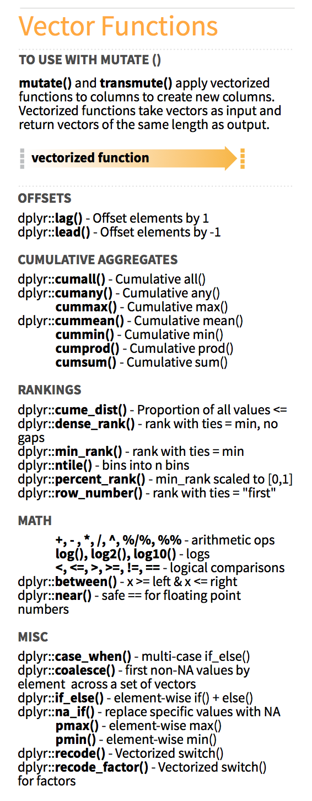
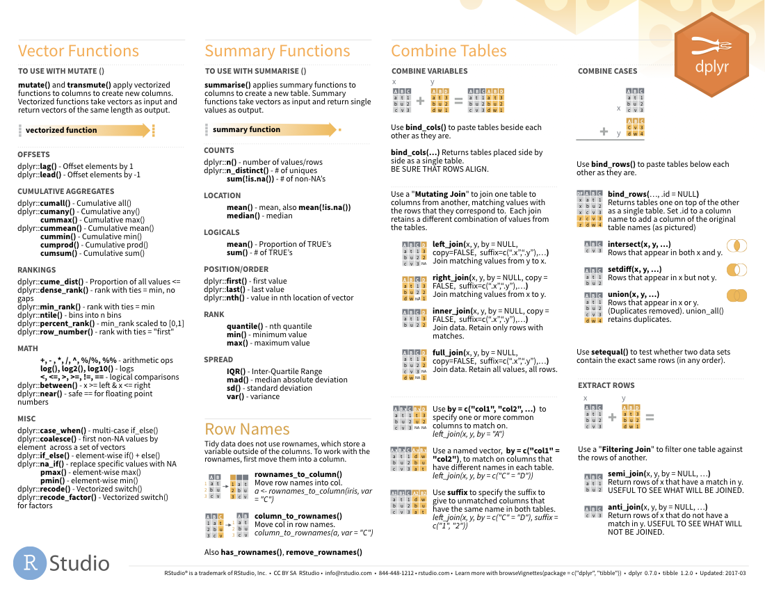

Functions to use in mutate()
on back
Notes:
There are tons of functions that you can use in the context of a mutate function, beyond just mathematics there are functions for ranking for creating cumulative aggregates, and many more found in the dplyr cheat sheet.

Slide 37
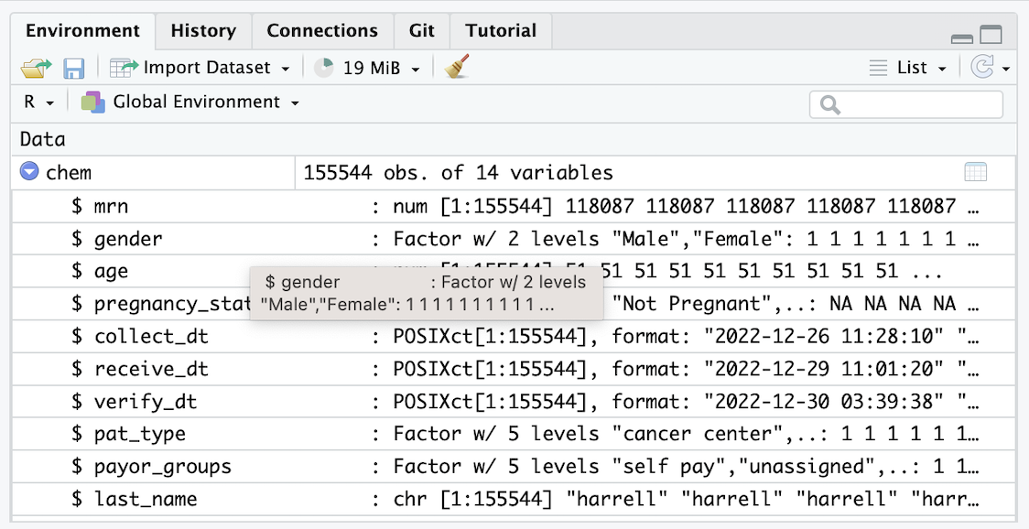
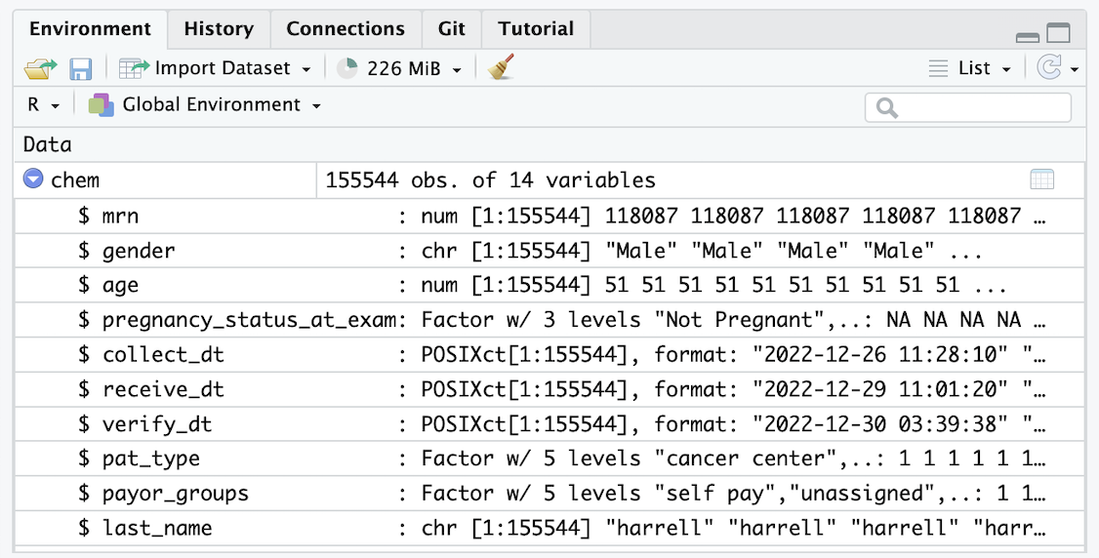
mutate()
Function to "coerce" one type of data into another type of data
Replacing columns
mutate(chem, gender = as.character(gender))

Slide 38
mutate()
Conditionally replacing values
mutate(chem,
last_name = if_else(last_name == “huffman”, “HUFFMAN”, last_name))
mrn | gender | last_name | test
5000876 | female | harrell | creatinine
5006017 | male | huffman | globulin
5001412 | female | coffee | glucose
5000533 | female | baldwin | iron
mrn | gender | last_name | test
5000876 | female | harrell | creatinine
5006017 | male | HUFFMAN | globulin
5001412 | female | coffee | glucose
5000533 | female | baldwin | iron

Slide 39
What Else?
Notes:
In this last part of this session, I want to show a few additional things you can do with ggplot, without going into much detail.

Slide 40
select()
Extract columns from a data frame
= Number of rows
↓ Number of Columns
Notes:
Here you see the graphical framework for how select works. You provide the raw data as the input in the form of a data frame.
It will extract the columns of your choosing and return these columns as a new data frame.
In the output, you will wind up with all the rows that you started with and just the columns defined in the select function.

Slide 41
select()
Extract columns from a data frame
select(data,... )
select(chem, mrn, last_name)
data frame to transform
name(s) of columns to extract
(or a select helper) function)
dplyr function
data frame to transform
Notes:
So let's take a look at the syntax. You can see here that select() conforms to the syntax of all dplyr functions.
Select takes the starting data frame as its first argument. In this case it’s the "covid_testing" data frame.
After that it takes any number of additional arguments that specify the columns that you want to pick.
In it’s simplest form, those additional arguments will just be the names of the columns that you want to select. For example in this case we are indicating that we want to keep the mrn and last_name columns.
In very wide datasets, writing out the names of the columns you want just doesn’t scale so dplyr does have additional convenience functions that can help you succinctly identify the columns you want. We won't go over these together but they can be found in the data transformation cheat sheet in the appendix to your coursebook.

Slide 42
select()
Extract columns from a data frame by name
select(chem, mrn, last_name)
chem
description | department
PROTHROMBIN TIME | INTERNAL MEDICINE CLINIC
BASIC METABOLIC PANEL | INTERNAL MEDICINE CLINIC
THYROID STIMULATING HORMONE | ENDOCRINOLOGY CLINIC
T4, FREE | ENDOCRINOLOGY CLINIC
mrn | gender | last_name | test
5000876 | female | harrell | creatinine
5006017 | male | huffman | globulin
5001412 | female | coffee | glucose
5000533 | female | baldwin | iron
mrn | last_name
5000876 | harrell
5006017 | huffman
5001412 | coffee
5000533 | baldwin
…
…
Notes:
So for example, if you were to run the code you see here, the snippet of the covid_testing data frame on the left would be accepted as input and a subset of it, the mrn and the last_name would be returned as output

Slide 43
select()
Extract columns from a data frame by name
select(chem, -mrn, -last_name)
chem
description | department
PROTHROMBIN TIME | INTERNAL MEDICINE CLINIC
BASIC METABOLIC PANEL | INTERNAL MEDICINE CLINIC
THYROID STIMULATING HORMONE | ENDOCRINOLOGY CLINIC
T4, FREE | ENDOCRINOLOGY CLINIC
mrn | gender | last_name | test
5000876 | female | harrell | creatinine
5006017 | male | huffman | globulin
5001412 | female | coffee | glucose
5000533 | female | baldwin | iron
gender | test
female | creatinine
male | globulin
female | glucose
female | iron
…
…
Notes:
Also by the way you if you put a little minus sign before the name of the column then select will actually EXCLUDE that column from the output.
So in this example we put a minus sign in front of column name mrn and last_name, and the snippet of covid_testing in the output only retains the first_name and gender columns

Slide 44
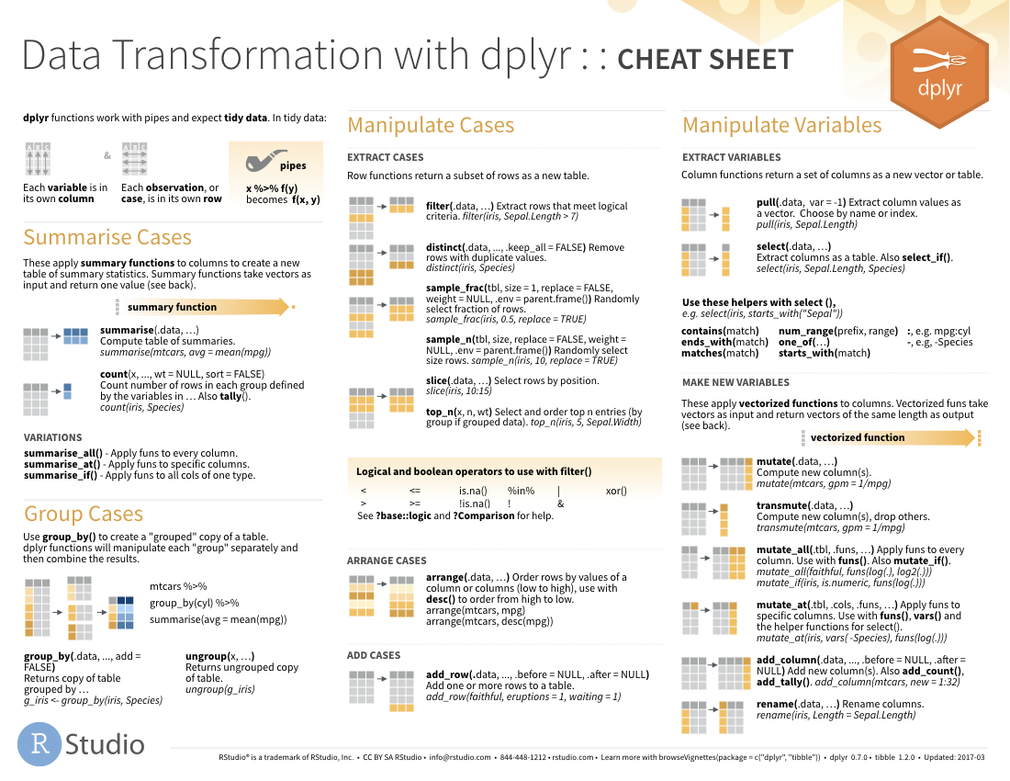
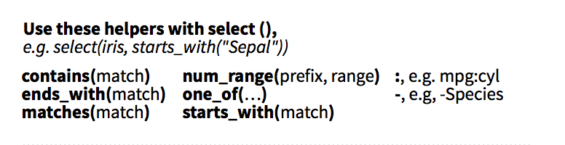
select() helpers
Notes:
I mentioned earlier that select actually has a bunch of helper functions that are there if you want to use a shortcut rather than writing out all the columns you want. So you can do term matching, you can select all columns between two columns, like the third through the tenth.
For a complete list, see the select() section on the dplyr cheatsheet in your appendix

Slide 45
select()
Renaming columns
select(chem, MRN = mrn, gender, last_name)
chem
mrn | gender | last_name | test
5000876 | female | harrell | creatinine
5006017 | male | huffman | globulin
5001412 | female | coffee | glucose
5000533 | female | baldwin | iron
MRN | gender | last_name
5000876 | female | harrell
5006017 | male | huffman
5001412 | female | coffee
5000533 | female | baldwin
…

Slide 46
arrange()
Order rows by values in a column
= Number of rows
= Number of Columns
Notes:
Arrange doesn’t so much change your data as much as organize it
Often when exploring your data you’ll be interested in ordering the rows according to values in a specific column or columns. That’s what arrange() does. It let’s you focus on the most important parts of your data by rearranging and organizing it.

Slide 47
arrange()
Order rows by values in a column
arrange(data,... )
data frame to transform
name(s) of columns to arrange by
Notes:
arrange conforms to the general syntax of dplyr function. The data frame is your first argument. After that you can list one or more columns, each separated by a comma, to arrange the data frame by.

Slide 48
arrange()
Order rows by values in a column
arrange(chem, last_name)
mrn | last_name
5000876 | harrell
5006017 | huffman
5001412 | coffee
5000533 | baldwin
mrn | last_name
5000533 | baldwin
5001412 | coffee
5000876 | harrell
5006017 | huffman
Notes:
In this example we are arranging covid_testing data frame by the first_name in ascending alphabetical order

Slide 49
arrange()
Order rows by values in a column
arrange(chem, desc(mrn))
mrn | last_name
5000876 | harrell
5006017 | huffman
5001412 | coffee
5000533 | baldwin
mrn | last_name
5006017 | huffman
5001412 | coffee
5000876 | harrell
5000533 | baldwin
Notes:
By default arrange will order the rows from smallest to largest, from a to z, or from earliest date to latest depending on what type of data is in the column that we're arranging. We can reverse this by wrapping our column of interest in the desc() function.
So in this example our output is a data frame in ascending MRN order.

Slide 50

Transforming data
Extract variables with select()
Extract rows with filter()
Arrange rows, with arrange().
Add calculated columns with mutate()
Notes:
So far we’ve covered functions whose primary job is to reshape your data but don’t fundamentally tell you something about what’s inside of it.

Slide 51
Lesson Goals
Perform basic data cleaning and preparation steps to facilitate analysis
Illustrate best practices for organizing data in spreadsheet-based (rectangular) formats for use in data analytics
Lesson Objectives
Apply logical criteria to determine which observations in a dataframe are included in a subset
Create a new variable based on a calculation applied to other variables
Notes:
In the second session we will learn some fundamentals of coding including using functions, creating objects, and importing data.

